Slide 1
NODE.JS
GLOBAL MENOTING
FILESYSTEM AND STREAMS
January, 2019

Slide 2
AGENDA
FS module
Working with files
Streams
Readable and writable streams
Child process module
Cluster module

Slide 3
FS MODULE
Operates with classes:
Methods groups:
Stats – describe base information about file or directory
FSWatcher – allow us to work with file changes
ReadStream – readable file Stream
WriteStream – writable file Stream
FileHandle – wrapper for File Descriptor
File content
Placement
Directories
Properties and permissions
File Descriptor lifecycle
Events handling
Streams
Also uses constants and flags:
Access (work with fs.access())
Copy (work with fs.copyFile())
File open (work with fs.open() that also can be modified by flags, e.g. “r” or “w”)
File Type and Mode (work with Stats class)
Feature of Node.JS 10:
fsPromises module
FileHandle – File Descriptor for fsPromises

Slide 4
FS MODULE METHODS
File content:
Directories:
File Descriptor:
readFile*^
writeFile*^
appendFile*^
read*^
write*^
ftruncate*^/truncate*^
fdatasync*^/fsync*^
mkdir*
mkdtemp*
readdir*
rmdir*
open*
close^
Handling:
Properties and Permissions:
watch
watchFile
unwatchFile
access*
exists
fstat*/stat*^/lstat*
futimes*/utimes*^
chmod*^/fchmod*/lchmod*
chown*^/fchown*/lchown*
Placement:
Streams:
copyFile*
rename*
link*
symlink*
readlink*
realpath*
unlink*
createReadStream
createWriteStream
* - fsPromises submodule;
^ - fileHandle has own

Slide 5
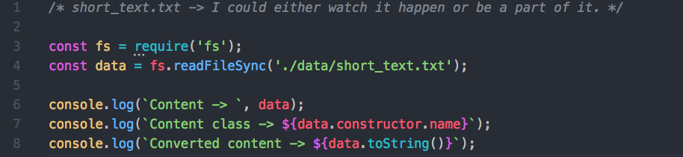
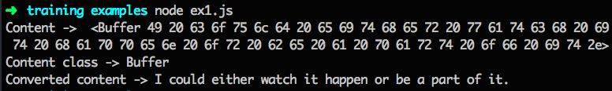
WORKING WITH FILES (BASIC EXAMPLE)

Slide 6
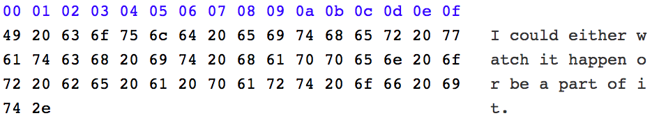
CLASS BUFFER AND BINARY FILESYSTEM
How our text looks like in HEX format:
Data in binary format | 0100 1001 | 0010 0000 | 0110 0011
Data in byte format | 49 | 20 | 63
Data in char format | I | *whitespace* | c

Slide 7
CLASS BUFFER
Buffer – class which wraps ”Uint8Array” typed array of 8-bit unsigned integers.
(dec: 0 – 255; hex: 0 – FF; binary: 0000 0000 – 1111 1111)
Size of the buffer is determined at initialization and after that it cannot be changed.
Using Buffer as constructor “new Buffer” is deprecated, use instead:
Buffer.alloc()
Buffer.concat()
Buffer.from()
Methods:
toString() - decodes to a string according of the specified character encoding (utf-8 by default)
Properties:
[index] – index iterator (inherited from Uint8Array)
length – size of memory given for current buffer

Slide 8
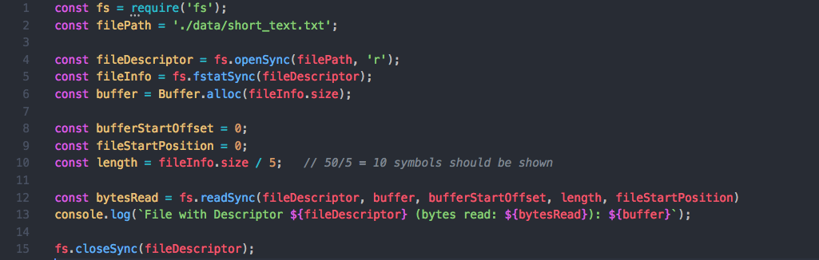
FILE DESCRIPTOR
Let imagine that we need to read first 1/5 part of file:
FileDescriptor – integer value which represents reference at an open file.
FileHandle – wrapper on File Descriptor for fsPromises submodule.

Slide 9
WATCHING FILE CHANGES
Two variants:
watchFile / unwatchFile()
watch() – newer implementation of watchFile/unwatchFile and should be always used instead of them. Return an instance of FSWatcher class.
Class FSWatcher:
event ‘change’ – emits when file changed, callback gets two arguments (eventType [‘rename’ or ’change’, filename)
event ‘close’ – emits when stops watching for changes
event ‘error – emits when an error occurs
method ‘close()’ – for stop watching the file

Slide 10
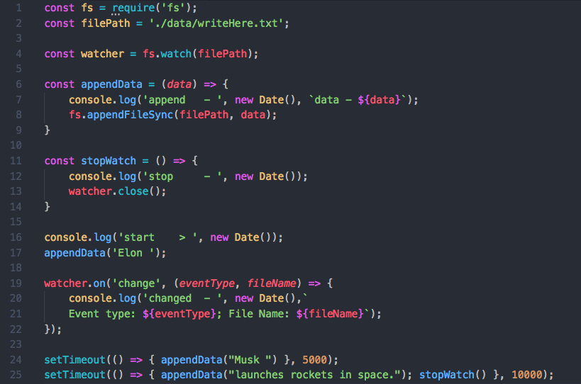
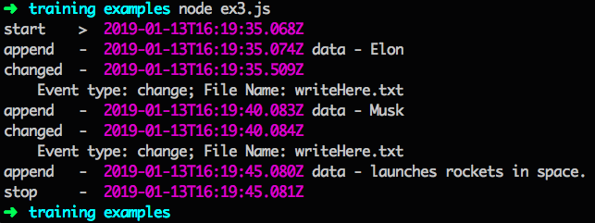
WATCHIN FILE CHANGES (EXAMPLE)

Slide 11
CLASS STREAM
What:
Abstract interface for working with streaming data in Node.js
Why:
To easily build objects that implement the stream interface and represent flowing data from any source
Types:
Readable – streams from which data can be read, e.g. fs.createReadStream
Writable – streams to which data can be written, e.g. fs.createWriteStream
Duplex – streams that are both Readable and Witable, e.g. net.Socket
Transform – streams that can modify or transform the data, e.g. zlib.createDeflate

Slide 12
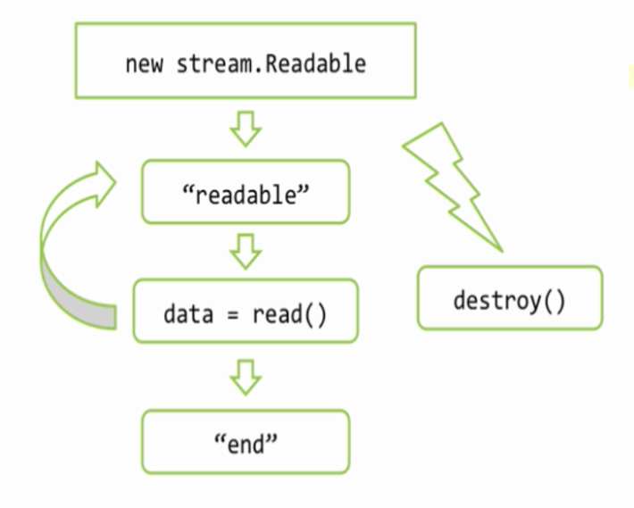
READABLE STREAM
Events:
‘readable’ – when stream ready for reading from his internal buffer
‘error’ – emits when an error occurs
‘end’ – when achieved end of source data
Methods
read() – read chunk of data from internal buffer of stream
read(N) – read chunk of data with N bytes

Slide 13
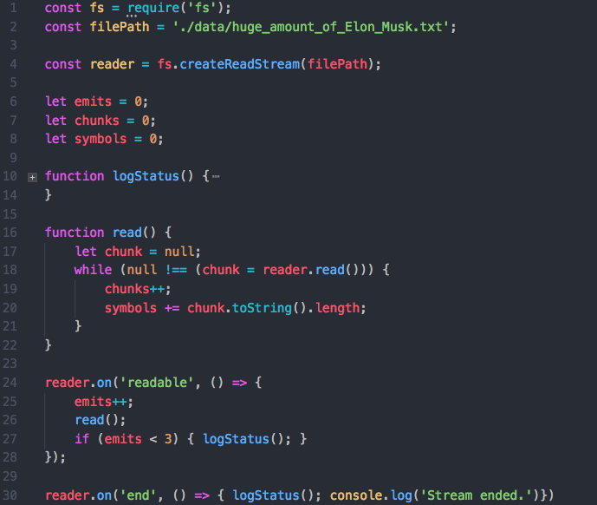
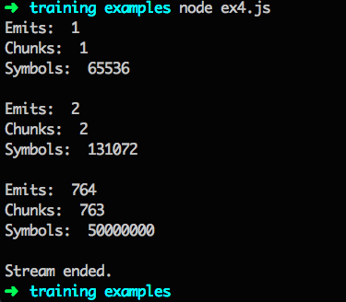
READ FILE STREAM IN PAUSE MODE EXAMPLE
File with 100k phrases
“Elon Musk launches rockets in space with tesla MS.” (50 sym length)

Slide 14
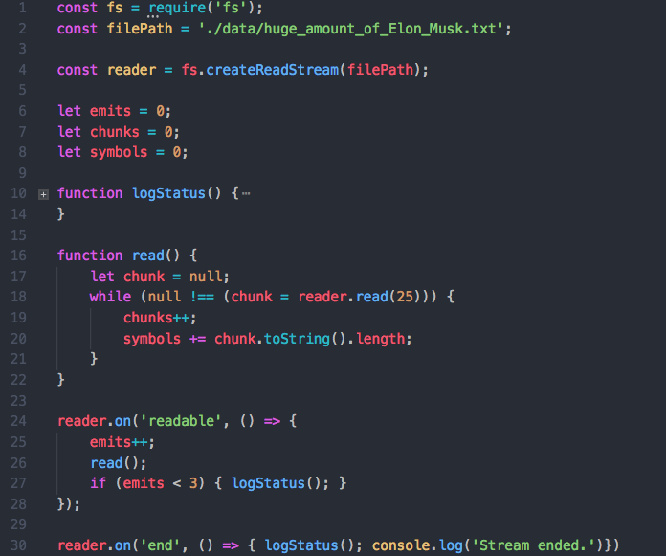
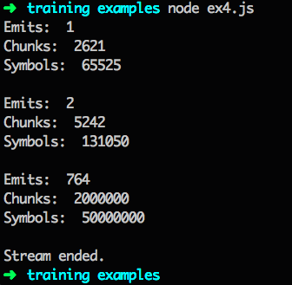
READ FILE STREAM IN PAUSE MODE EXAMPLE
File with 100k phrases
“Elon Musk launches rockets in space with tesla MS.” (50 sym length)

Slide 15
READABLE STREAM MODES:
Pause (by default):
By calling the stream.pause() mehod
By removing any ‘data’ event handlers and all pipe destinations by calling the stream.unpipe() method
Flow:
Adding a ‘data’ event handler
Calling the stream.resume() method
Calling the stream.pipe() method to send the data to a Writable

Slide 16
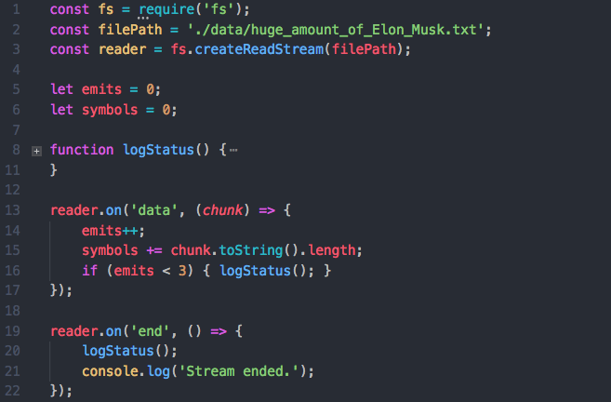
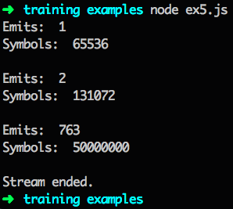
READ FILE STREAM IN FLOW MODE EXAMPLE

Slide 17
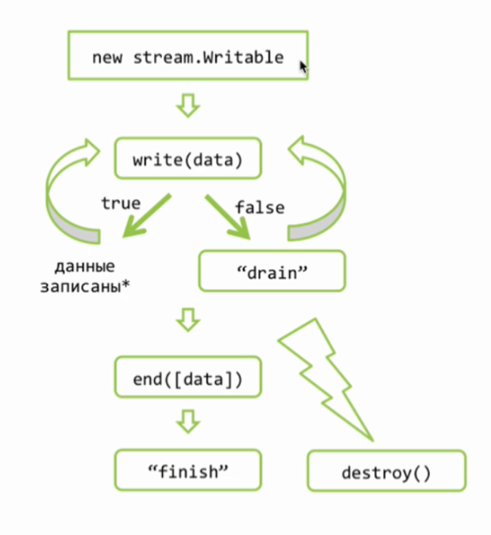
WRITABLE STREAM BASIC
Events
'drain’ – when internal buffer is ready to get new data by write() method
‘error’ – emits when an error occurs
‘finish’ - when end() called after all data from internal buffer where written
‘pipe/unpipe’ – when stream is piped/unpiped to readable stream
Methods:
write() – write data to internal buffer of stream, return flag
end() – finish working with stream, can take last chunk of data to write

Slide 18
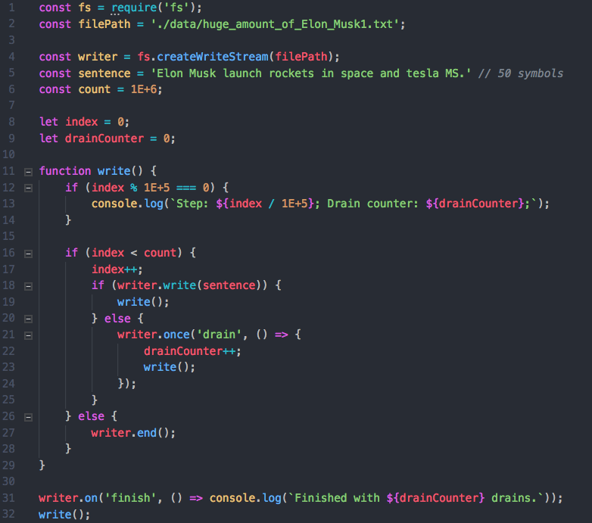
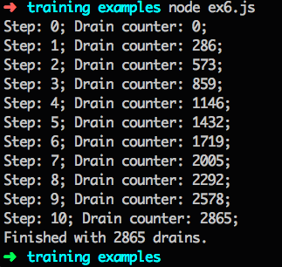
WRITE FILE STREAM EXAMPLE

Slide 19
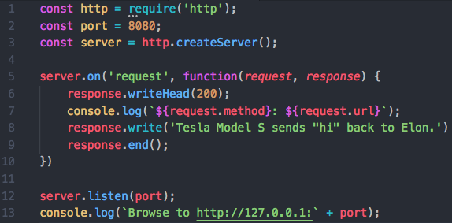
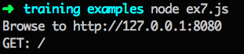
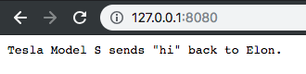
REQUEST/RESPONSE
Request:
Response:
Instance of class http.IncomingMessage
Implements Stream with type Readable
Instance of class http.ServerResponse
Implements Stream with type Readable

Slide 20
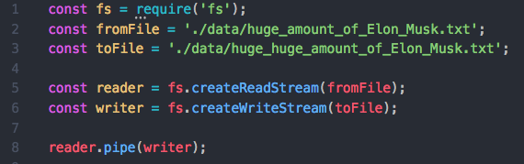
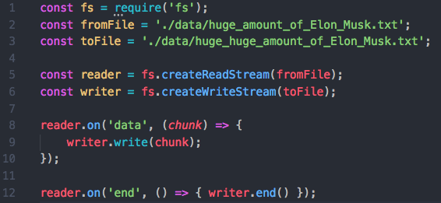
PIPE/UNPIPE METHOD
Connects writable stream to readable stream
Automatically transfers read data to writable stream
Automatically manages things like handling errors, end-of-files, cases when one stream is slower or faster than the other
Not recommended to mix with manual event handling (always choose: handle events or create pipe)
Pipe method:
Simplified event-equivalent method:
Can be simplified

Slide 21
CHILD PROCESS MODULE
‘child_process’ module for creating new process on OS and managing them.
Methods (all returns ChildProcess instance):
exec(command[, options][, callback]) – spawn a subshell and execute the command in that shell
execFile(file[, args][, options][, callback]) – executes an external application
fork(modulePath[, args][, options]) - spawn new Node.JS instance with running module in it
spawn(command[, args][, options]) – spawn an external application in a new process and returns a stream for I/O
-//- synchronous analogs
Class ChildProcess:
Emits child process events (close, disconnect, error, exit, message)
Lets send signals to child process (send, disconnect, kill)
Contains readable and writable streams for transferring data

Slide 22
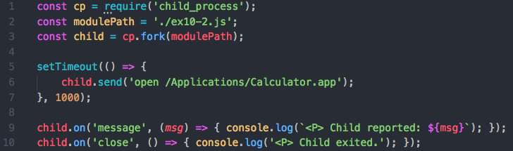
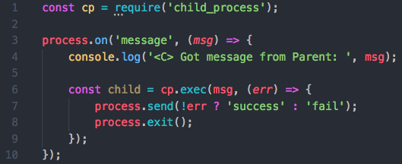
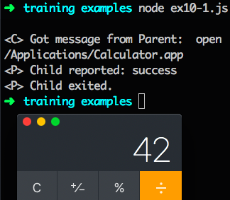
CHILD PROCESS MODULE USAGE EXAMPLE

Slide 23
CLUSTER MODULE
“cluster” – module for horizontal scaling Node.JS application
Method:
fork() – spawn a new worker process, returns Worker instance
Properties:
isMaster/isWorker – is/isn’t current process master-process
worker – reference to the current worker object (not available in the master process)
workers – object with IDs as keys and workers as values (only available in maser process)
Class Worker:
wraps ChildProcess instance which was originally created by child_process.fork()
property “id” – unique id for worker, key in cluster.workers
property “process” – ChildProcess instance
method “send()” – send a message to master (from worker) or to worker (from master)

Slide 24
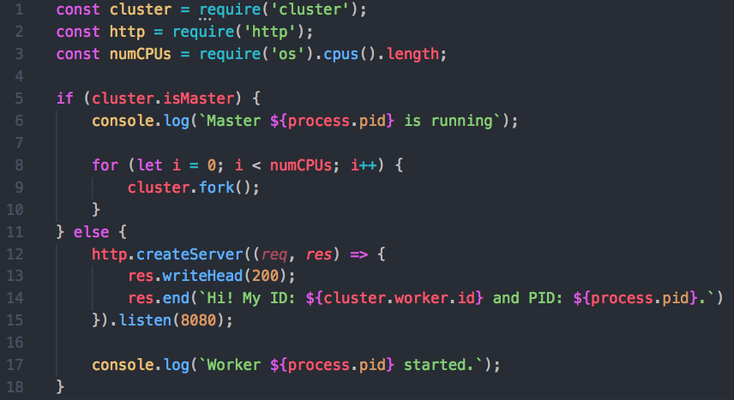
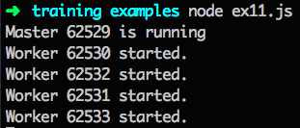
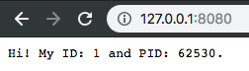
CLUSTER MODULE USAGE EXAMPLE
Cluster automatically recognizes which worker isn’t under high load

Slide 25
USEFUL LINKS
Node.js official FS module documentation
Node.js official Buffer documentation
Node.js official Streams documentation
Node.js official Child Process documentation
Node.js official Cluster documentation
Joel Spolsky «The Absolute Minimum Every Software Developer Absolutely, Positively Must Know About Unicode and Character Sets (No Excuses!)»
Samer Buna «Node.js Streams: Everything you need to know»
Samer Buna «Node.js Child Processes: Everything you need to know»
Samer Buna «Scaling Node.js Applications»

Slide 26
NODE.JS GLOBAL
NODE.JS FILESYSTEM AND STREAMS
BY
GENNADII MISHCHENKO DENIS VLASSENKO
MIKITA SUBBOT

